Slide 1
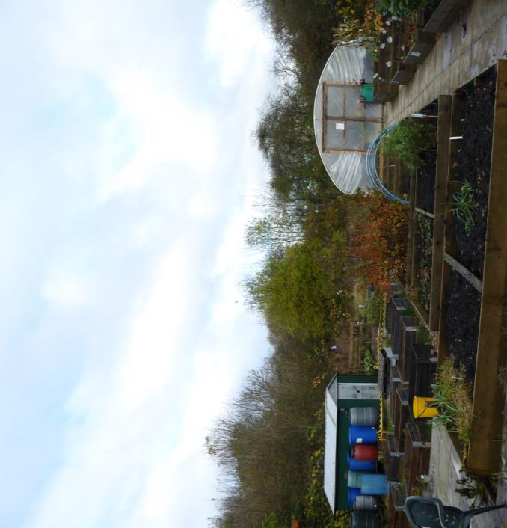
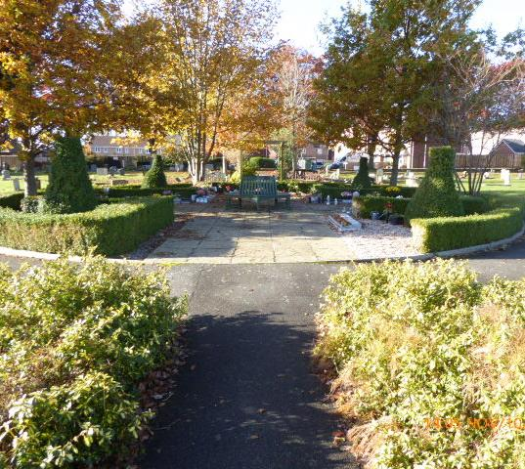


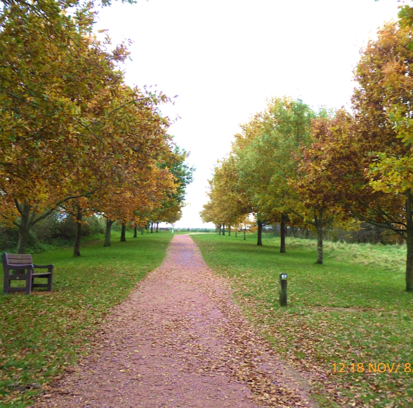
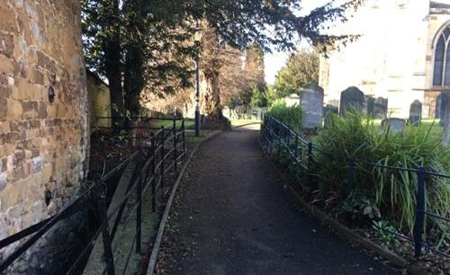


Melton Open Space Strategy 2020
Consultation presentation
Please also refer to the consultation draft strategy document for more detailed information.

Slide 2
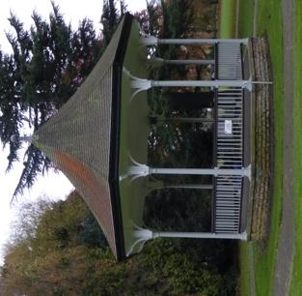
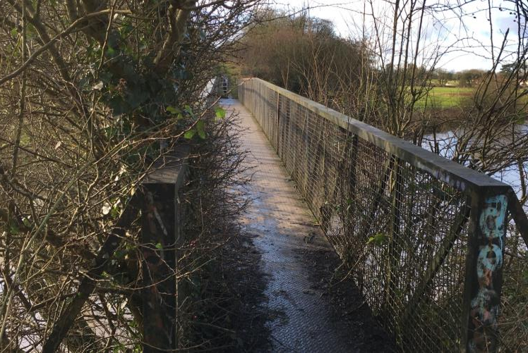
What is the Melton Open Space Strategy 2020
Delimited by the boundary of Melton Mowbray town not the whole Borough.
Evidence based report to support delivery of Council policies.
Replacement of a previous strategy dated 2015.
Compliant with national “Planning Practice Guidance”.
Comprehensive with a 60% increase in site auditing since 2015.
Includes a standalone review of cemetery provision.
Commissioned by the Borough Council and delivered by MD2 Consulting Ltd.
Completion expected autumn 2020.

Slide 3
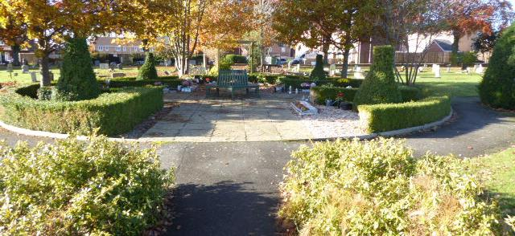
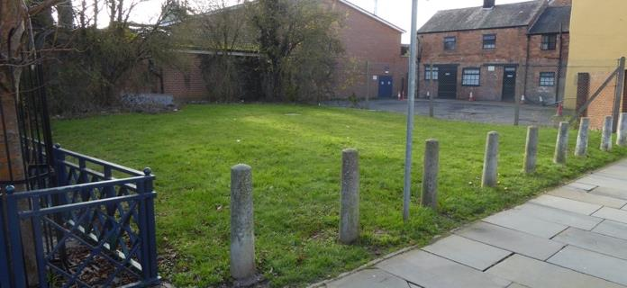
Objectives
Link to the Council’s Local Plan - especially policies EN7 (open Space) and EN3 (Green Infrastructure).
Link to the Council’s Corporate priorities
Provide clarity and transparency when seeking developer contributions for open space.
Respond to the declaration of the climate emergency.
Directly related to urban growth – creation of sustainable neighbourhoods.
Recognise other major changes of which the Melton Mowbray Distributor Road (MMDR) is most notable.

Slide 4
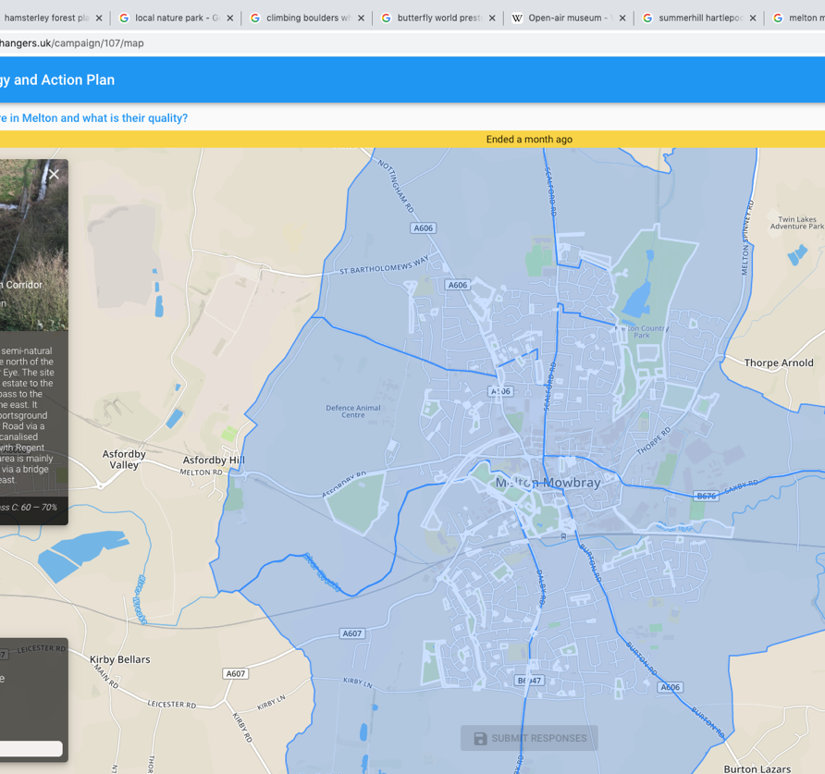
Methodology
Review of all relevant documents
Undertake audit (visits) to all sites giving them a quality score
Determine the role of other organisations such as the Town Estate
Compare with other authorities like Melton to ascertain realistic quantity and access standards.
Map and record on a database for future use.
Propose strategies, recommendations and an action plan.
Conduct a consultation.
Create an interactive web applet (see opposite).
Undertake a cemetery provision review.

Slide 5

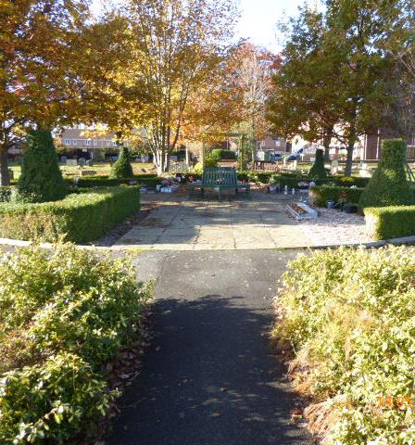
Melton Mowbray Cemetery Provision review
Findings
Previous estimates suggest that one hectare of new land will be needed that can be deliverable and operational during 2021.
Result of 2019/20 study – new or extended provision is indeed needed. Natural burial and crematoria services available elsewhere. For Melton Mowbray the issue is mainly one of conventional burial (body or ashes).
Two options – an extension of Thorpe Road (limited opportunity) or new provision.
15 sites investigated, two on the short list. Land within Country Park off Doctors Lane as an extension (close but not directly connected) and a new site off MMDR roundabout at Nottingham Road.
Logistical and legal land ownership issues will need to be resolved, e.g. restrictive covenants at Country Park and land ownership off MMDR.
Strategic partner needed so co-location with other services including crematoria and natural burial might be advantageous.
Road map on how to proceed included in the provision report.

Slide 6
Types of open space featured in the 2020 Open Space Strategy
Typology name | Notes
Allotments | Includes recognisable allotment gardens along with community growing spaces.
Amenity greenspace | Planned or incidental open space often (but not only) grass – amenity use, and visual appearance are key considerations.
Churchyard and cemeteries | These are considered only when they are publicly accessible areas and have a significant greenspace component.
Non-pitch sport facility | These are sites that may be missed in a Sport England compliant Playing Pitch Strategy which focuses on a small number of ‘key sports’.
Parks and gardens | Accessible parks and gardens, normally a formal landscape.
Provision for children and young people, e.g. play areas | Also referred to as playgrounds and play spaces.
Accessible natural greenspace | Wide ranging description for space that is for people and nature. An increasingly important component of green infrastructure and necessary to adapt to climate change.
^{[1]} In line with national practice four types are identified. LAPs – local areas of/for play, LEAPS – local equipped area of/for play, NEAPS – neighbourhood equipped areas of/for play, MUGA – multiuse games area.
^{[2]} Note that some local authorities count riverbanks, canal banks, old railway lines as a separate category called Green Corridors, but in Melton these are included in the Accessible Natural Greenspace category.

Slide 7
Overview of provision in Melton Mowbray
Findings
The town of Melton Mowbray has a large number of small sites.
There is a lack of connectivity between sites in the town.
There is an absence of a large publicly accessible site in the south of the town.
The River Eye and the former railway branch line are important green corridors in the town.
There are Multiple ownerships of open space in the town with the Council being the largest followed by the Town Estate and then others.
Whilst there is some creativity in the Open Space offer in the town there is an opportunity for more - especially with regards to the management of amenity open space.

Slide 8
Open Space Standards
Access(ibility)
Quality
Quantity
QUANTITY - Lower quartile – strong case for an increase.
QUANTITY - The standard for natural/semi natural space is very low, yet this type of open space is essential to climate adaptation.
ACCESS - The minute-drive standard is inappropriate in the face of the climate emergency given that it directs users to drive to sites. An alternative is to set a ‘cycle time’ although it should be noted that this has implications for future cycle infrastructure in both urban and rural areas.
ACCESS - When applying standards for walking distance (a linear measure), the calculation should take into account approved pedestrian crossing points.
QUALITY – Presently good but no reason to be complacent as decline comes about quicker than improvements.

Slide 9
Recommended standards 2020
Open space typology | Quantity standard 2015 (hectares per 1,000 population) | Access standard 2015 (measured in straight line) |  | Recommended quantity standard 2020 (hectares per 1,000 population unless indicated otherwise) | Recommended access standard 2020 (measured in straight line)
Allotments and community growing spaces | 0.26 | 15-minute walk or 1,200m |  | 0.30 | 15-minute drive in rural areas
Amenity Green space | 0.63 | 10-minute walk or 800 metres |  | 0.60 | 10-minute walk or 800 metres
Parks and gardens | 2.08 | 15-minute walk or 1,200 metres | 10-minute drive in rural areas | 2.08 | 10-minute walk or 800 metres | 15-minute cycle ride in rural areas
Provision for children and young people. | 0.13 | 10-minute walk or 800m | 10-minute drive in rural areas | 0.25 | 10-minute walk or 800m | 15-minute cycle ride in rural areas
Semi-natural greenspace | 0.29 | 10-minute walk or 800 metres | 20-minute drive in rural areas | 1.80 | 10-minute walk or 800 metres | 20-minute cycle ride in rural areas
Total open space (sum of above) | 3.39 | Not applicable | Not applicable | 5.03 | Not applicable
Green is an increase, yellow is the same, red is a decrease.

Slide 10

Quantity headlines from the town of Melton Mowbray No. 1
Findings
Allotments and community growing spaces - in all population scenarios the town of Melton Mowbray has a deficiency of allotment and community growing spaces. There are opportunities for the Council to redesign some of its excess of amenity greenspace to create new allotment(s) and especially community growing spaces.
Amenity greenspace - even with a reduction in the Standard the town of Melton Mowbray will not be below standard until 2036 and then only marginally. There is an opportunity to reconfigure existing amenity green space to other typologies which are deficient – notably allotments and community growing spaces or semi-natural greenspace.

Slide 11
Quantity headlines from the town of Melton Mowbray No. 2
Findings
Parks and gardens - presently the town of Melton Mowbray is ahead of standard but will be marginally behind by 2026 and extremely so by 2036. A new urban park(s) will be needed within this time frame, likely between 2025 – 2030 if the standard is to be maintained by the end of the local plan period.
Provision for children and young people - in all future population scenarios, the town of Melton Mowbray will still be ahead of standard by 2036. However, care is needed in distribution as in new sustainable neighbourhood’s local areas of play (LAPs) or locally equipped areas for play (LEAPs) will still be required for younger children in line with the access standards.
Semi-natural greenspace - there is a deficiency of semi-natural greenspace in the town of Melton Mowbray and to reach the Standard an additional 47.2 hectares will be needed by 2036.

Slide 12
How to meet the 2020 quantity standard in the town of Melton Mowbray
a.) A new urban park or several parklets totaling 10 hectares is needed in the town of Melton Mowbray,
b.) That some existing amenity greenspaces could be converted to either allotments/community growing space or semi-natural greenspace,
c.) That a deficiency identified in mapping shows the need for a major new accessible ‘semi-natural greenspace’ south of the town. This has much greater potential for biodiversity and recreational activities that require ‘more space’,
d.) It is recommended that the new accessible semi-natural greenspace is of at least 47.2 (say 50) hectares to be implemented through the next local plan review,
e.) Green infrastructure connectivity in Melton Mowbray is presently weak and when possible opportunities to link green areas together should be taken to improve this.
f.) Proposals c. and d. above cannot be delivered through the current Local Plan and will need to be incorporated within the next Local Plan review.

Slide 13
Access headlines
Findings
Access to open space is for the most part good to very good in Melton Mowbray.
Access to allotments and community gardens -there is an uneven distribution and there is a need for new provision especially in the south of the town and west of Nottingham Road.
Access to amenity greenspace - there is good access and short term opportunities to reconfigure some sites to address deficiencies in other types of open space.
Access to provision for children and young people - there will be a continuing need for Local Areas of Play (LAPs) and Locally Equipped Areas of Play (LEAPs) for younger children in new sustainable neighbourhoods. However, Neighbourhood Equipped Areas of Play (NEAPs) and Multiuse games areas (MUGAs) should be focused on larger settings notably in the south of the town.
Access to parks and gardens - the current distribution of parks and gardens is very dependent on three geographical clusters within the town. Key locations to be considered for new provision would be west of Nottingham Road in the north west of the town and between Sandy Lane and Burton Road in the south east.
Access to semi-natural greenspace - Melton Mowbray has a limited quantity of accessible semi-natural greenspace and what provision there is limited in terms of its connectivity

Slide 14
Quality audit measurement
Findings

Slide 15
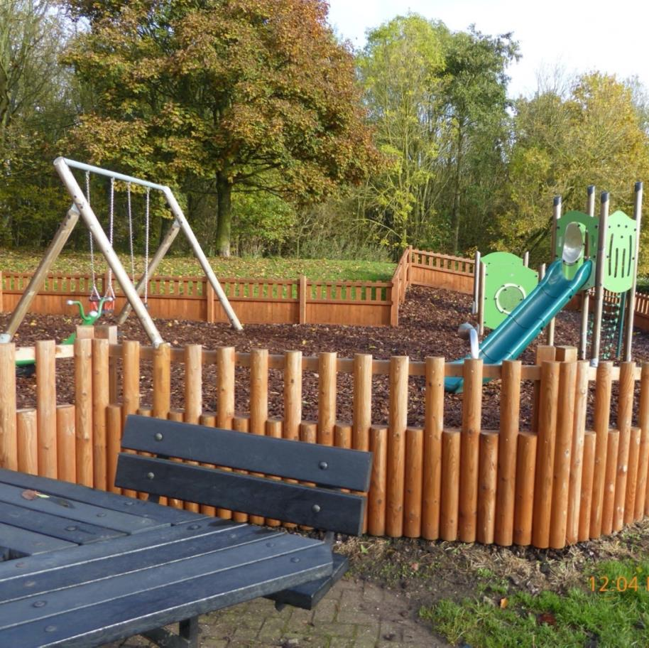
Vision statement 2020 - 2036
Ensure that during the life of the Melton Local Plan that open spaces in Melton Mowbray deliver the most benefits to residents and visitors whilst simultaneously contributing to the town’s green infrastructure network, especially to benefit nature and help the town address the challenges of climate change.

Slide 16
The open space strategy 2020 -2036 – a plan of action designed to achieve the vision statement.
QUALITY - to maintain and whenever possible enhance open space quality
QUANTITY - to exceed whenever possible the quantity standard for each open space ‘type’ identified in the 2020 open space strategy by 2036.
ACCESS - to ensure that throughout the life of the Melton Local Plan that residents of Melton Mowbray have sufficient access to open space to meet their needs.
FINANCE - That there is sufficient finance available between 2020 and 2036 to ensure that existing open space is maintained to the highest quality, that progress in improving quality where it is deficient is available and that there are monies available for new provision.
EVENTS - That there is support for the use of Open Space for events and other activities and that this is encouraged, as it builds civic pride and fosters public engagement with individual open spaces.

Slide 17
Meeting future needs
Ensure that developer contributions meet the appropriate public open space and recreation needs of the community in the short and longer term. Developers will be asked to make a capital contribution to open space creation and a revenue contribution for management.
Scale of development | Local area for play (LAPs) | Locally equipped area for play (LEAPs) | Neighbourhood equipped areas for play (NEAPs) | Multi-use games area (MUGAs)
10 – 49 | * | *
50 – 99 | * | * |  | Contribution
100 + | * | * | * | Contribution

Slide 18
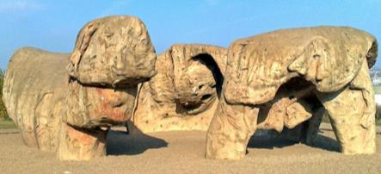
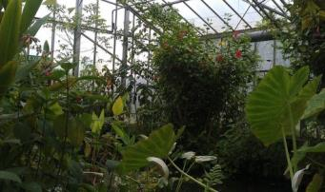

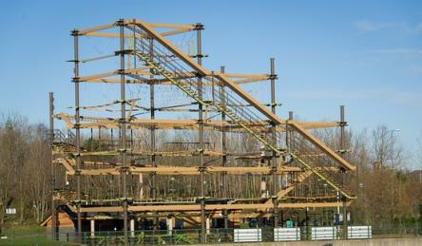
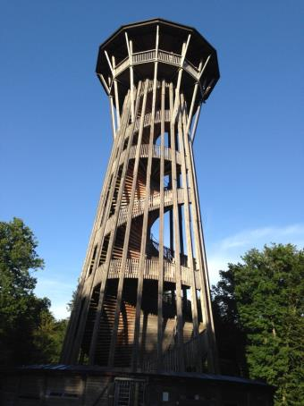
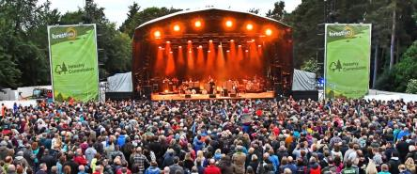
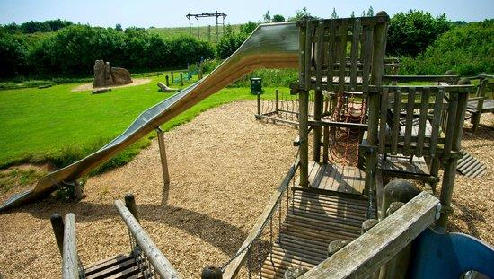
Future opportunity
Melton Mowbray Natural Park
This is the title for a concept of a new major open space destination for the south of Melton Mowbray. The site should preferably be located adjacent to the MMDR (southern section) and close to proposed new sustainable neighbourhoods. The site would be a counterpoint to the existing Melton Country Park in the north of the town and if developed successfully, it would make a major contribution to the achievement of recommended open space standards. The facility should be in excess of 50 hectares, with a predominantly semi-natural character.

Slide 19

Take home messages
The new Strategy is for the town of Melton Mowbray not the whole Borough.
Quality is generally good to very good – well done to the Council.
Long term investment is needed to maintain quality.
There is an opportunity to reclassify some types of open space by changing their management and purpose.
New standards are more in keeping with similar local authorities.
Population growth between 2020 and 2036 will lead to a need for new provision (especially parks and local areas of play) – Developer’s responsibility.
There are deficiencies in quantity in some types of open space.
Need for more semi-natural greenspace to address climate emergency and improve green infrastructure within the town of Melton Mowbray.
Need for new cemetery provision either by an extension into part of Melton County Park or a new facility accessed via MMDR.
Next step 1: extend audit and strategy to the whole of the Borough to ensure a level playing field, comparability and a robust Local Plan evidence base.
Next step 2: An opportunity exists for a new c. 50ha plus ‘Melton Natural Park’ south of the town feasibility study needed.
Major changes will need to be included in the next local plan review as they cannot be delivered under the current one.

Slide 20

QUESTIONS

